Slide 1
OBJECT ORIENTED DESIGN PATTERNS
Team PT02
1 Oct 2016

Slide 2
Design Problem
The system must be able to accept other payment methods example cash.
Currently the transaction controller is creating the coin receiver class explicitly.

Slide 3
Candidate Design Considered
Factory Design Pattern
Parameterized Factory
Singleton

Slide 4
Motivation
Extensibility. When a new payment method is added (cash) to the factory, no other class need to change.
Singleton to ensure only 1 instance of CoinReceiver is returned.

Slide 5
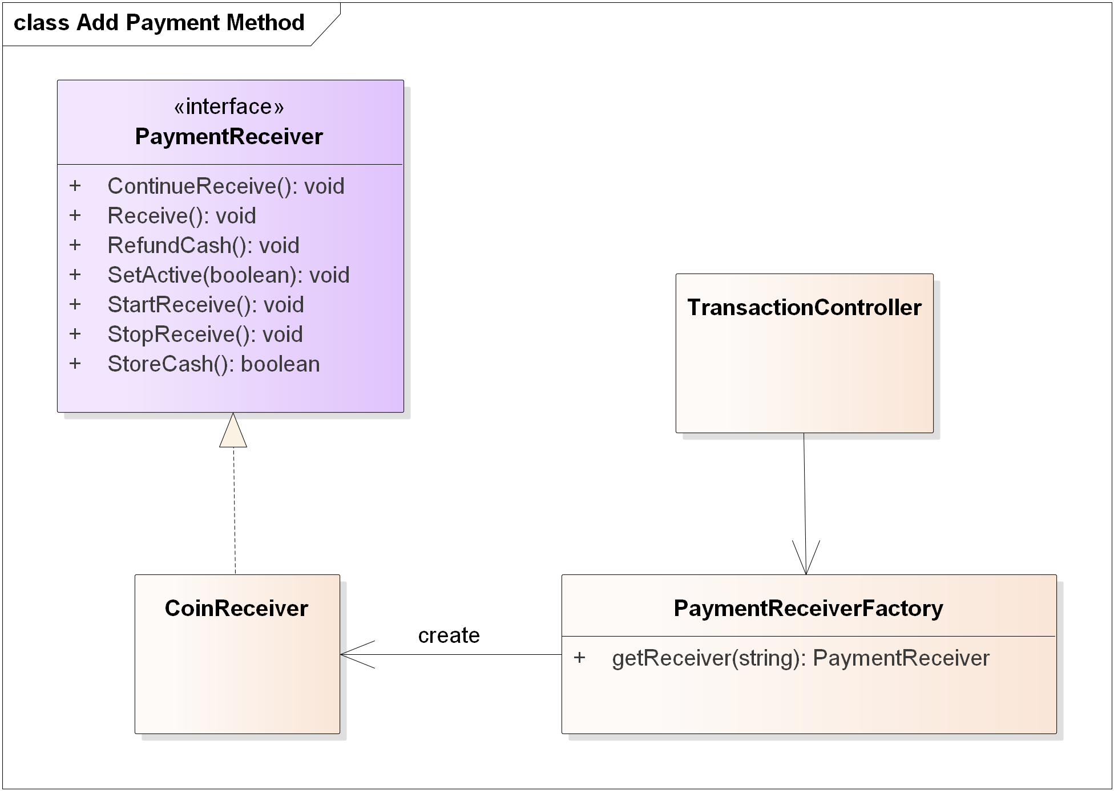

Slide 6
